Slide 1
Successful Strategies for Using Online Video as an Outreach Tool CASFAA Conference – December 14th -16th 2013 Leslee Heinrichs

Slide 2
Today’s Objectives…
Communication Methods
Effective Communication for Reaching Today’s Student
Maximizing OnLine Video as Communication Tool
Increased Efficiency in Financial Aid Office

Slide 3
Methods of Communication….then and now….

Slide 4
Most Common Methods of Communication Still Used Today….
7. Paper
9. Newspaper
11. Telephone
13. Television
14.5 Cell Phone
15. Internet
16. Instant Messenger
17. Blogging
18. FaceBook
19. YouTube
20. Twitter

Slide 5
How do we reach our students?
Regulations changes
LEU
Loan Interest Rates
Understanding policy
SAP
How to complete the FAFSA on-line

Slide 6
Most Common Used by Financial Aid Office….
Paper / Newsletter
Telephone / Cell Phone
Internet / Email
Social Media

Slide 7
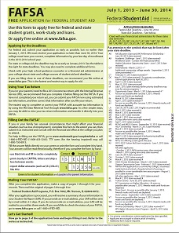
Paper…
Becoming obsolete?
Paperless office?

Slide 8
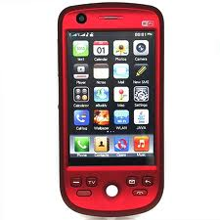
Telephone / Cell Phone
Students can call with questions to get
information
FAAs can contact students to provide information
Turn around time?

Slide 9
Internet / Email
A school’s webpage can be a source of information for students
What information is included? How much?
Email is a quick way to communicate. Turn around policy?
Broadcast email
Record of communication

Slide 10
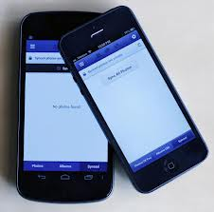
Social Media
Majority of students participate
Quick one-way communication
Can receive feedback
Mobile
Can reduce amount of visits students make to the financial aid office (ie deadline alerts).

Slide 11
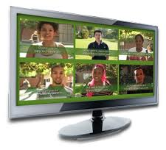
Online Video
Visual method of learning
Multiple topics – your choice
Provides alternate to reading pages of text
Multiple views if necessary
Audio/visual stimulation
Answers to questions on demand at any time of day or night

Slide 12
Video Usage Options….
Self-service internet portal
Foothill College
Mobile device access
Embed link to video in email blast
Post video on your FB page
Video embedding on college or university website
Foothill College
California State University
Mt. San Jacinto College
Playing video content on school signage system
Counseling sessions

Slide 13
Self-service internet portal – Foothill College

Slide 14
Mobile device access
Responsive Embedding

Slide 15
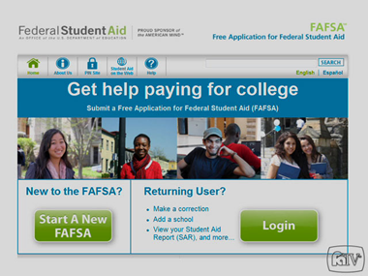
Embed link to video in email blast …
Dear Student,
It is time to complete your 2013/2014 FAFSA application. To help you through this process and answer some of your questions, please click on the image below which will take you to a quick tutorial on how to complete the FAFSA.
2013/2014 FAFSA Tutorial:
Have a great day!
--
Suzie Administrator
Financial Aid Office
971.555.2323

Slide 16
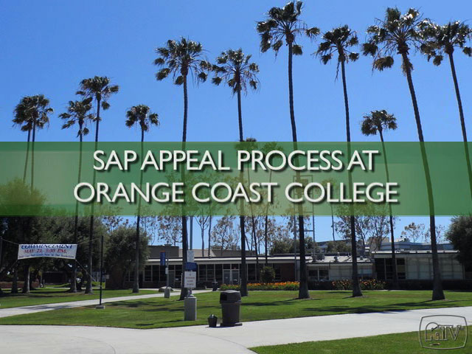
Embed link to video regarding policy…
Dear Student,
We are very interested in your success as a student at OCC. To better assist you in understanding the satisfactory academic progress appeal process, please click on the image below to watch a short video on our process. Once you have viewed this video, if you have further questions, please contact the financial aid office.
Suzie Administrator
OCC Financial Aid Office
971.555.2323

Slide 17
Post video on your FB page NOVA FB Page

Slide 18
Video embedding on college website - Foothill College California State University

Slide 19
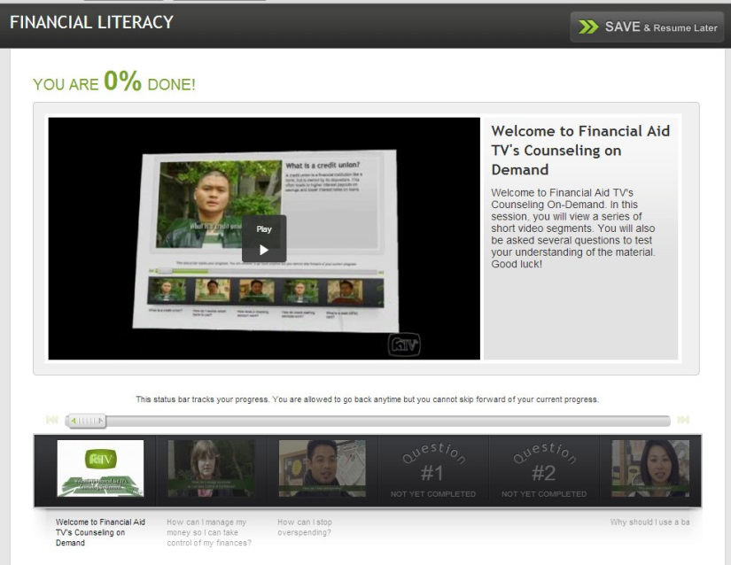
Video Counseling Session…
Create a counseling session on any topic using videos
Financial Literacy
SAP
Applying for Financial Aid
Track completion with email alerts

Slide 20
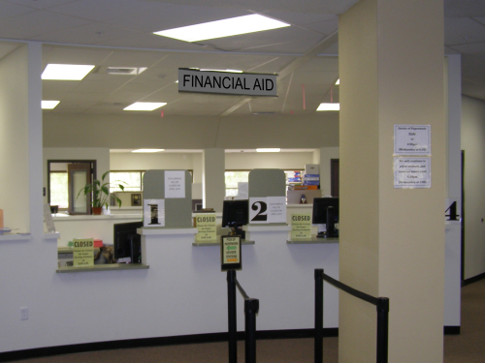
Benefits….
Improve customer service
Reduction in answering repetitive questions
Reduction in voicemail messages to return
Increase financial aid applications
Reduce wait times and phone calls
Expand reach of counseling team
Tackle default aversion

Slide 21
What your colleagues are saying….
“While a beneficial side-effect may be the reduced volume of calls and visits from confused students, the real reason we implemented FATV was to have fewer confused students. We may even do one better and that is to reach students using Financial Aid TV who otherwise would never have come forward to apply for aid. We look forward to the coming year and positive outcomes.”
Kevin Harral, Director of Financial Aid,
Foothill College

Slide 22
Impact on Ivy Tech Staff…
Reduction in answering repetitive questions
Over 45,000 student questions have been answered in the first 3 months by FATV
Positive student feedback and enthusiasm among staff
Consistent messaging across 14 campuses

Slide 24
Thank you!

